Slide 1
Solving the N-Queens Problem: Hill-Climbing and Simulated Annealing
Present By : Akshay Kumar

Slide 2
AGENDA
Introduction
Background
Literature Review
Methodology
Professional and ethics
Reference

Slide 3
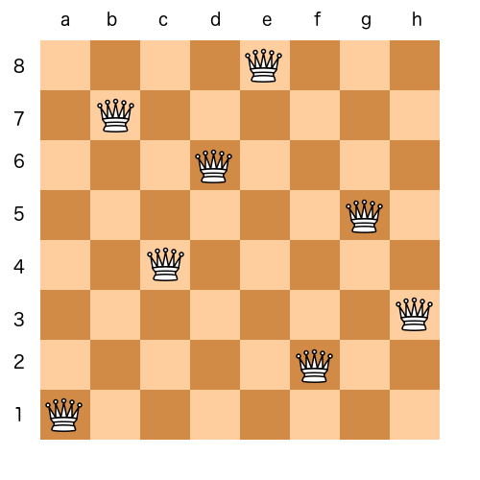
INTRODUCTION
Briefly introduce the N-Queens problem.
State why it's significant in the field of computer science and optimization. -Algorithm Design, CSP, Optimization, Parallel Computing
Discuss How can we solve the N-Queen problem .

Slide 4
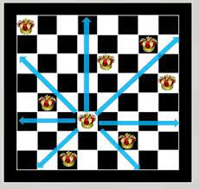
Background
A concise description of the N-Queens problem.
Historical context or previous approaches used to solve it. – Backtracking and Brute force algorithms
Visual representation of the problem (e.g., a chessboard with queens).

Slide 5
Literature Review
Discuss key studies or papers that have tackled the N-Queens problem. – Research contributed to various aspects of mathematics and computer science.
Highlight different methods previously used and their outcomes. – Brute force, Backtracking, GA, etc
Show how my approach differs or builds upon these methods. – Hill climbing and Simulated Annealing

Slide 6
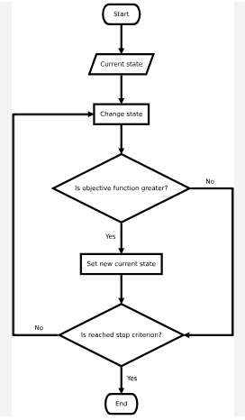
Methodology
Two primary algorithms I will use: Hill-Climbing and Simulated Annealing.
Hill-Climbing Algorithm: as an iterative optimization algorithm.
it starts with a random solution and iteratively makes small changes (or moves), each time moving to a neighboring solution that improves the objective function.

Slide 7
Methodology
Simulated Annealing Algorithm: inspired by the physical process of annealing in metallurgy.
its ability to escape local optima by accepting worse solutions with a certain probability
how to applied these algorithms specifically to the N-Queens problem.

Slide 8
Professional and Ethics
Scalability : Hill climbing and simulated annealing algorithms can face challenges as the problem size increases.
Intellectual Honesty : implementation is based on or inspired by existing work, proper attribution and citation should be given. Plagiarism is unethical and undermines the integrity of the work.
Fair Use of Resources : If the implementation requires significant computational resources.

Slide 9
references
[1] Lajtar M., Implementacja i porównanie wybranych metod w problemie N-królowych, BSc Thesis
supervision Grzegórski S., Lublin University of Technology (2011).
[2] http://www.etsi.org/plugtests/grid/Document/N-QUEENS-CHALLENGE-2007-v4.pdf
(01.10.2012).
[3] Wirth N., Program Development by Refinement, Communication of the ACM (1971).
[4] Letavec C. Ruggiero J., The n-Queens Problem, INFORMS Transcations on Education (2002).
[5] Tesler G., n-Queens, Math 188 (2001).
[6] http://jsomers.com/nqueen_demo/nqueens.html (01.10.2012).
[7] Hać M., Brzuszek M, Równoległe rozwiązanie problemu N-królowych z wykorzystaniem standardu
OPENMP, Scientific Bulletin of Chełm 1 (2008).
[8] Rok S., Jun G., Polynomial Time Algorithms for the N-Queen Problem, ACM SIGART (1990).
[9] Alfeld P., The N by N Queens Problem, Univerity of Utah (1997).
[10] Chatham R. D., Reflections on the N + k Queens Problem, Integre Technical Publishing (2009).
[11] http://www.academic.marist.edu/∼jzbv/algorithms/Backtracking.htm (01.10.2012).
[12] http://proactive.inria.fr/index.php?page=nqueens25 (01.10.2012).

Slide 10
THANK YOU
Akshay Kumar
Akshaymalhi012@gmail.com

